Slide 1
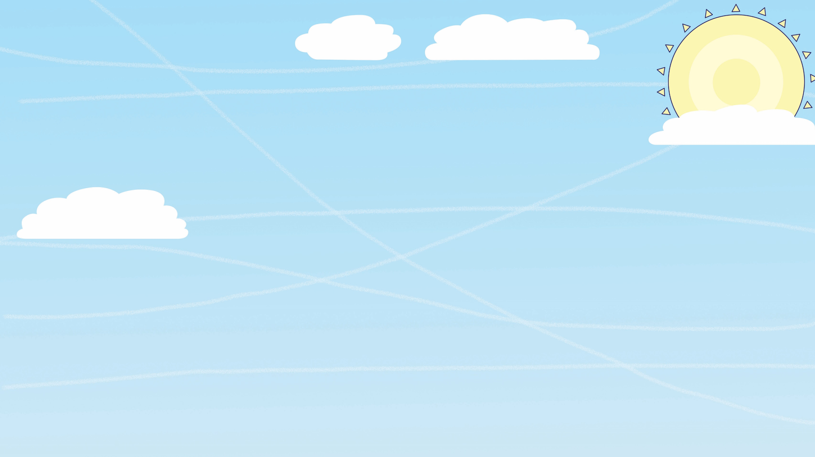
FLY HIGH
FRIDAY
© Launchpad Publishing Ltd 2018, illustrations © Clive Goodyer

Slide 2
Challenge
Who can make paper fly the farthest?
Let’s learn how to make paper fly…

Slide 3
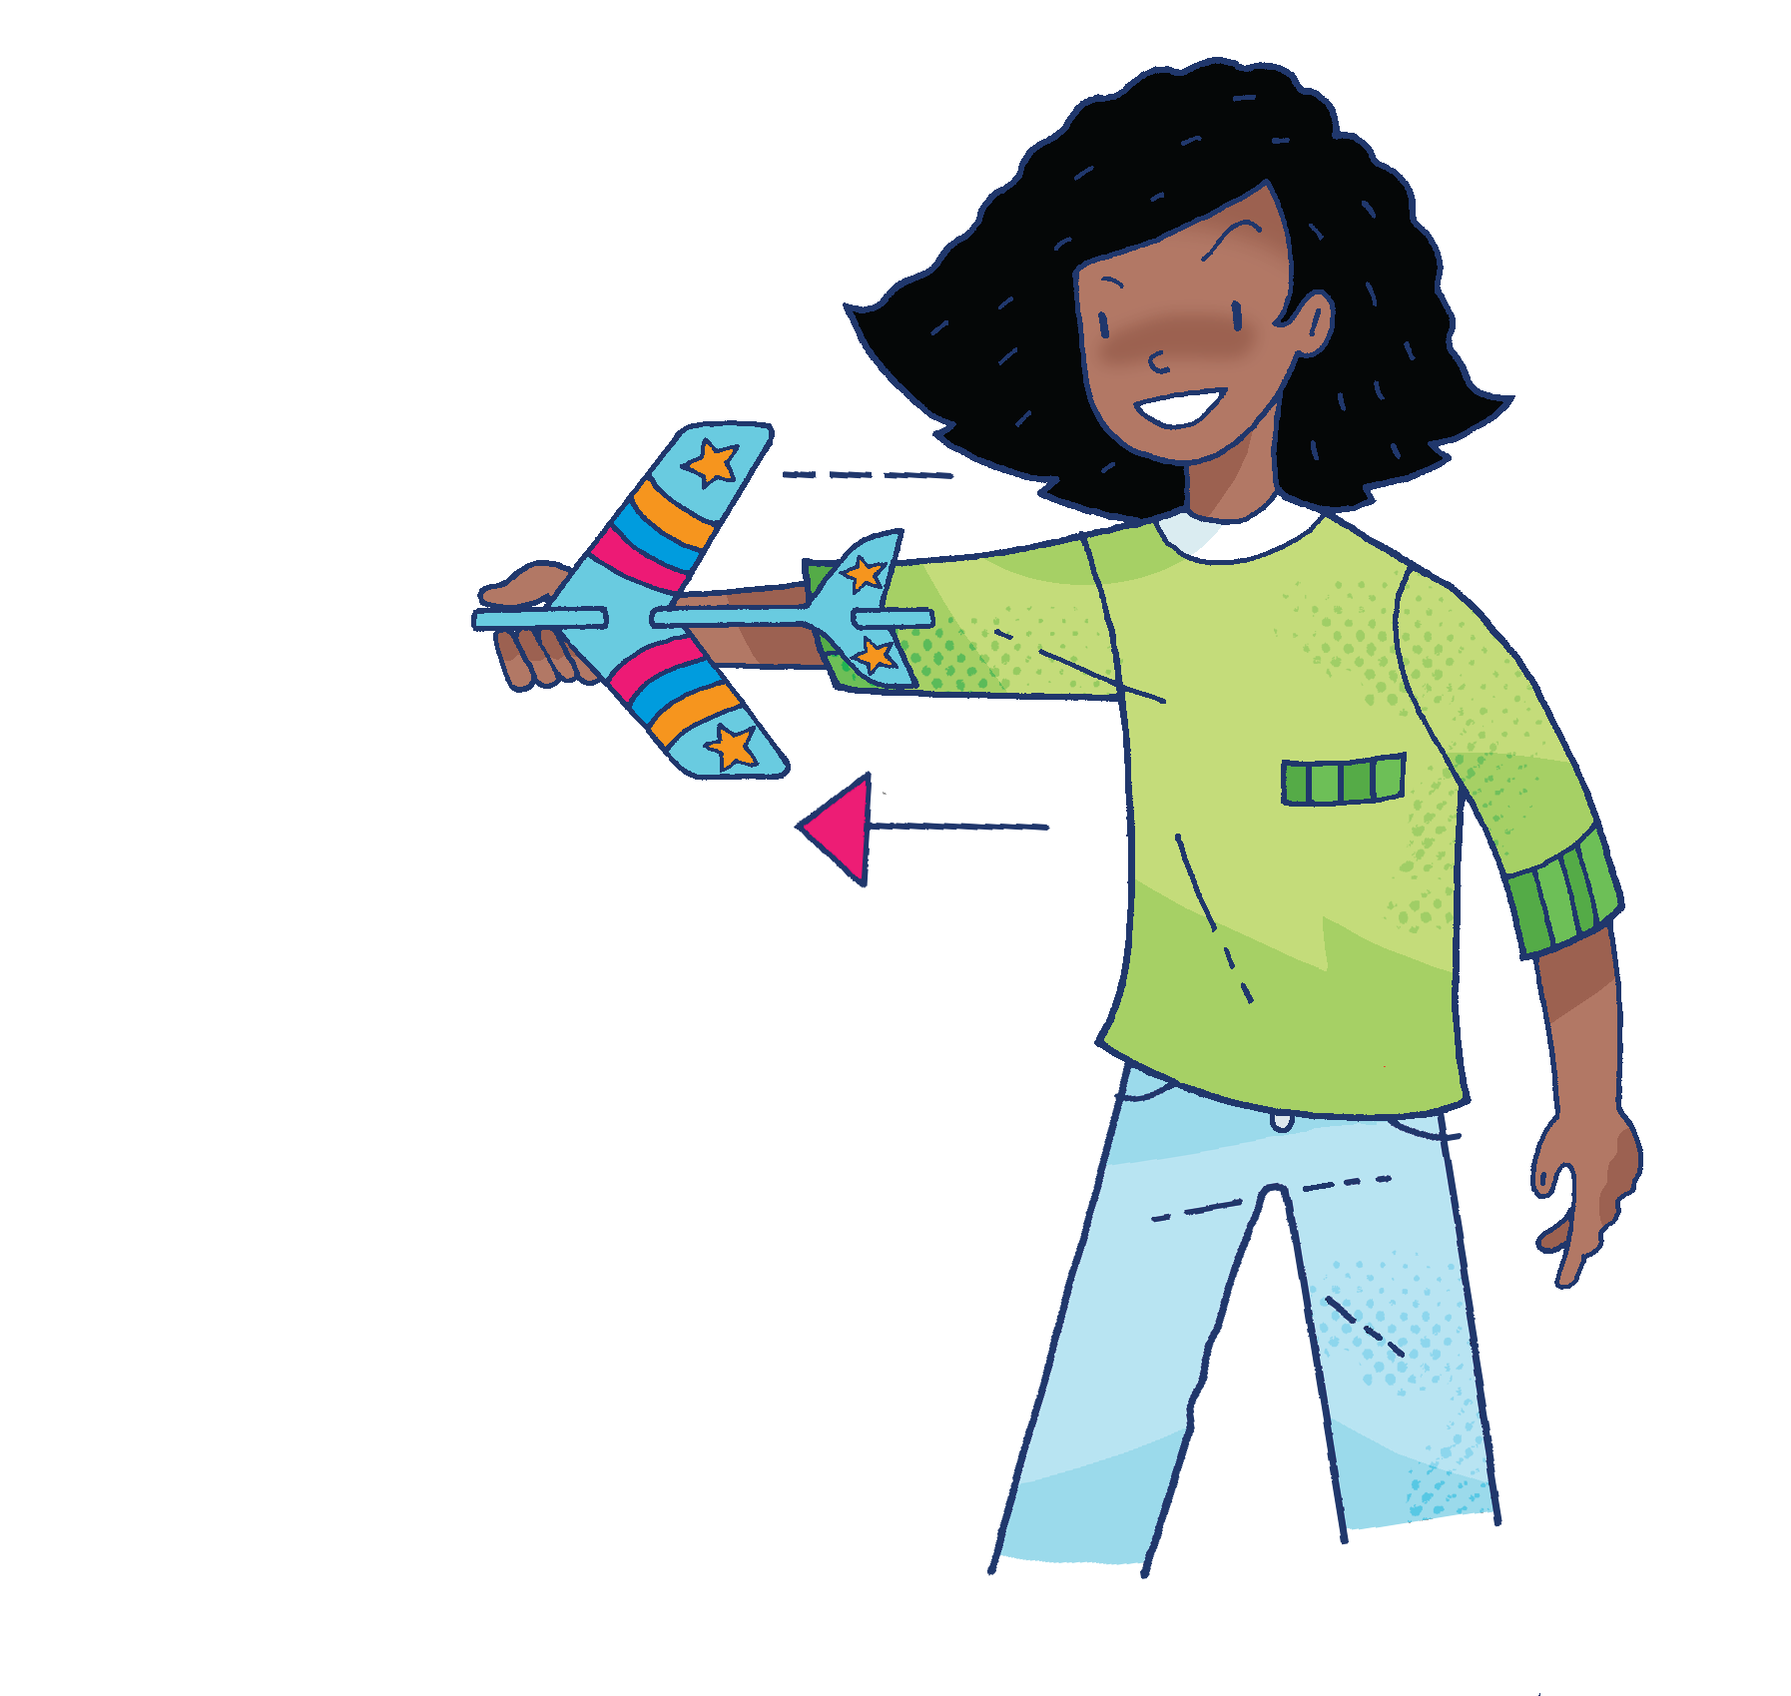
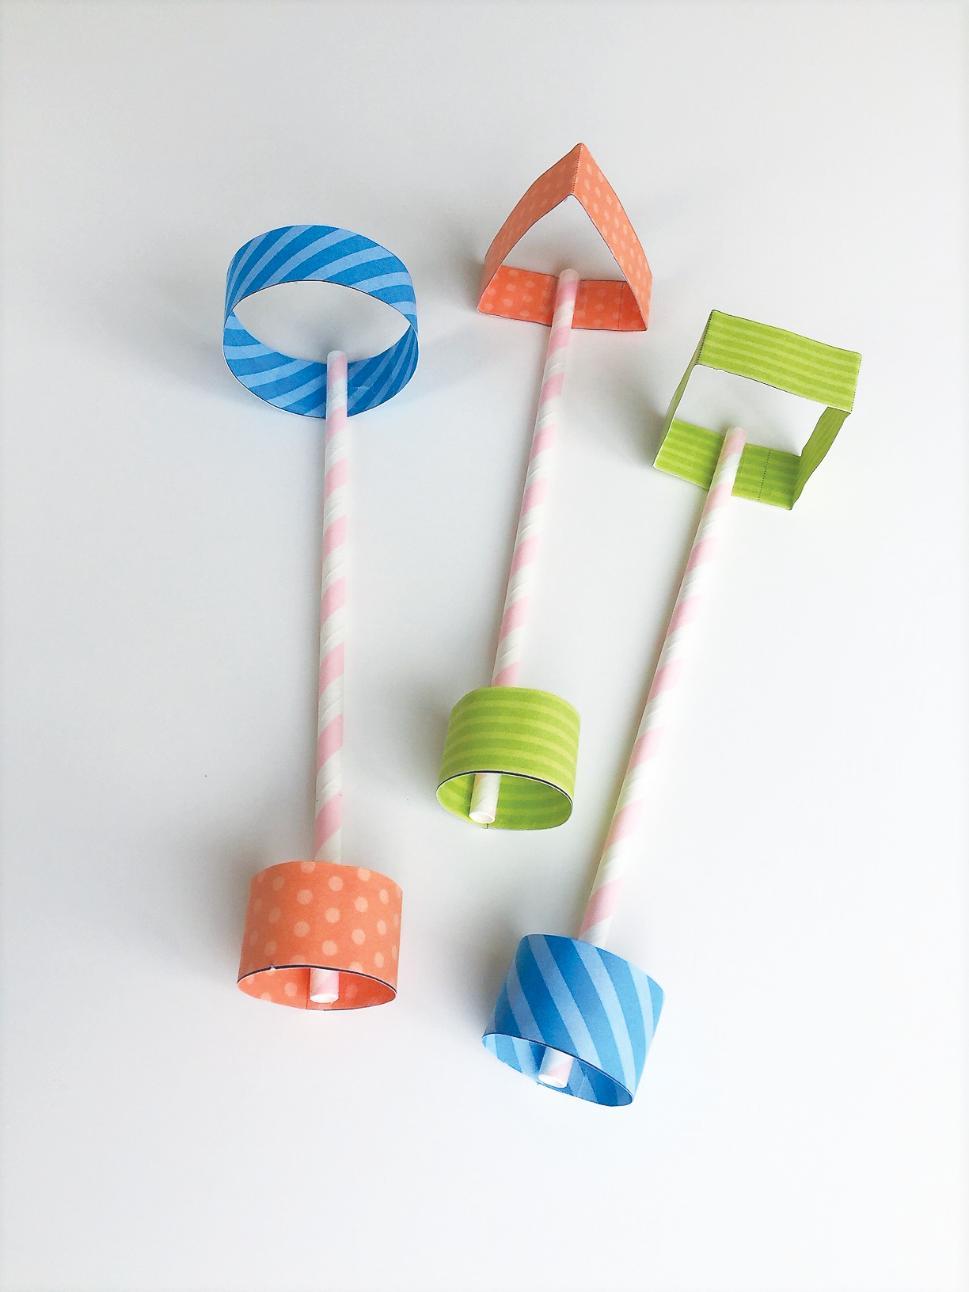
There are lots of different ways to make paper fly. Try these out…
How will you measure how far it will fly?
Straw planes
Air-powered rocket
Stunt plane

Slide 4
Try the air-powered rocket.
Evaluate
What could you do to make it fly farther?

Slide 5
Now try the straw planes.
Evaluate
Which shape flies the farthest?

Slide 6
Finally, the stunt planes.
Is it easy to measure how far they fly?

Slide 7
Record your results as a class.
Now decide which one worked best. Then see how far you can make it fly.
Straw planes
Air-powered rocket
Stunt plane

Slide 8
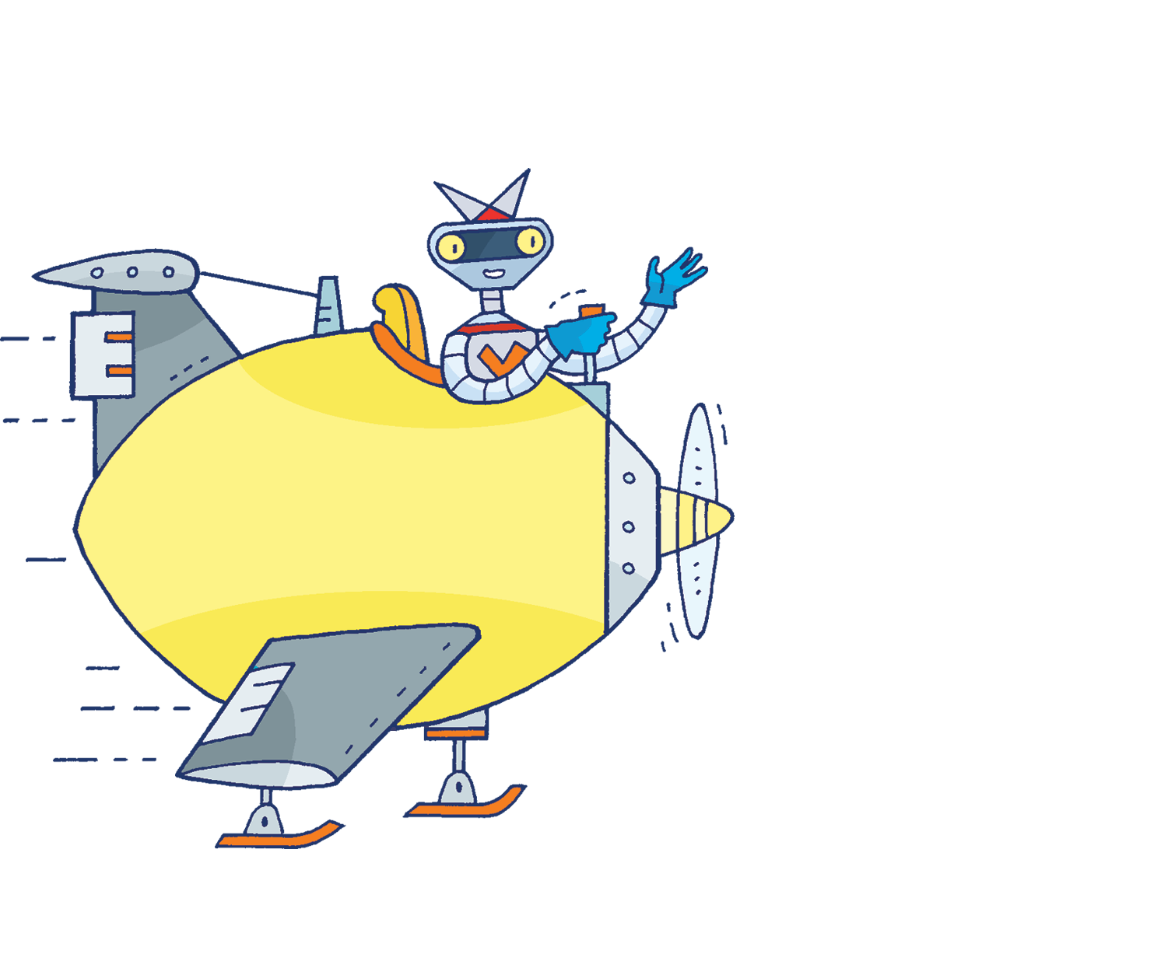
Don’t forget to share your results with the rest of the school. Good luck!

