Slide 1
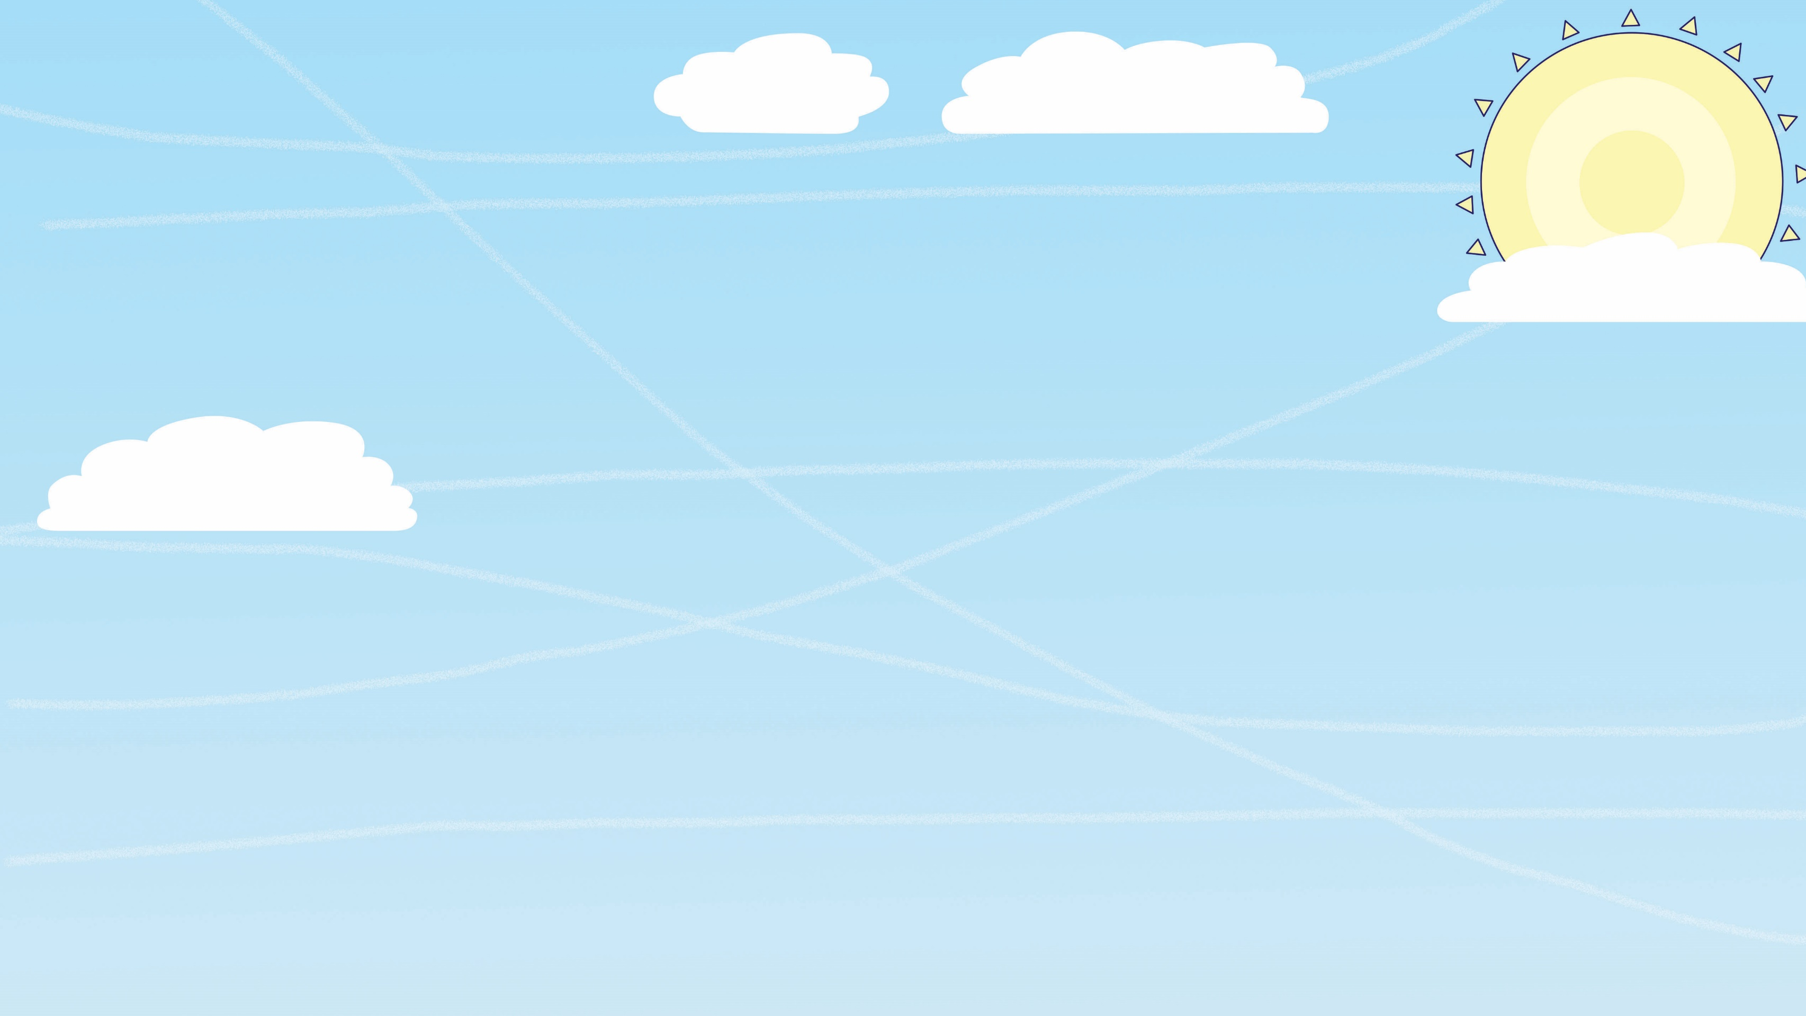
FLY HIGH
FRIDAY
© Launchpad Publishing Ltd 2018, illustrations © Clive Goodyer

Slide 2
Challenge
Who can make paper fly the farthest?
Let’s learn how to fly…

Slide 3
Up, up and away!
Welcome to the Whizz Pop Bang Flying Club! Fasten seatbelts and chocks away!
FLYING LESSON 1:
What makes something fly?
Thrust pushes it forward
Four forces affect any flying plane, bird or custard pie…
Drag, or air resistance, is a form of friction that slows down objects moving through the air. Gravity makes unsupported objects fall towards the Earth.
Drag slows it down
Gravity pulls it down
Lift pushes it up

Slide 4
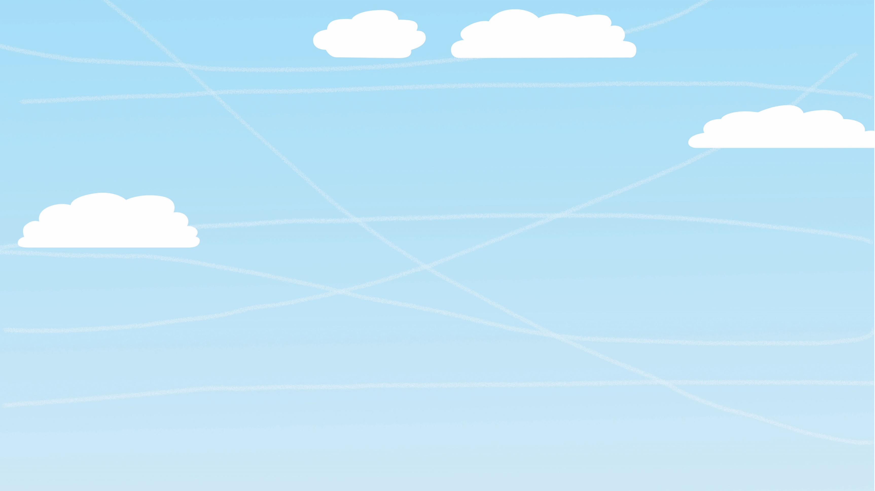
HOW WINGS CREATE LIFT
As a plane speeds along the runway, air flows around the wings. The curved shape of the wings creates a pressure difference between the top and bottom of the wing: the air forced below the wing has a higher pressure than the air forced above it, which pushes the wing upwards, creating lift.
Another way of thinking about it is that the shape and angle of the wing makes the air coming off the wing flow downwards. This produces an upward force on the wing and creates lift. It’s Newton’s third law of motion in action!
More thrust means faster air over the wings…
…which causes more lift.
Lower air pressure
Plane wings, propellers and birds’ wings are aerofoil-shaped to produce lift.
Air rushes downwards
Higher air pressure
LIFT

Slide 5
FLYING LESSON 3:
Why can’t I fly like a bird?
To fly like a bird you’d need a body like a bird.
It won’t work!
OK, I give up!
Streamlined body reduces drag
Super-strong chest muscles power wings

Slide 6
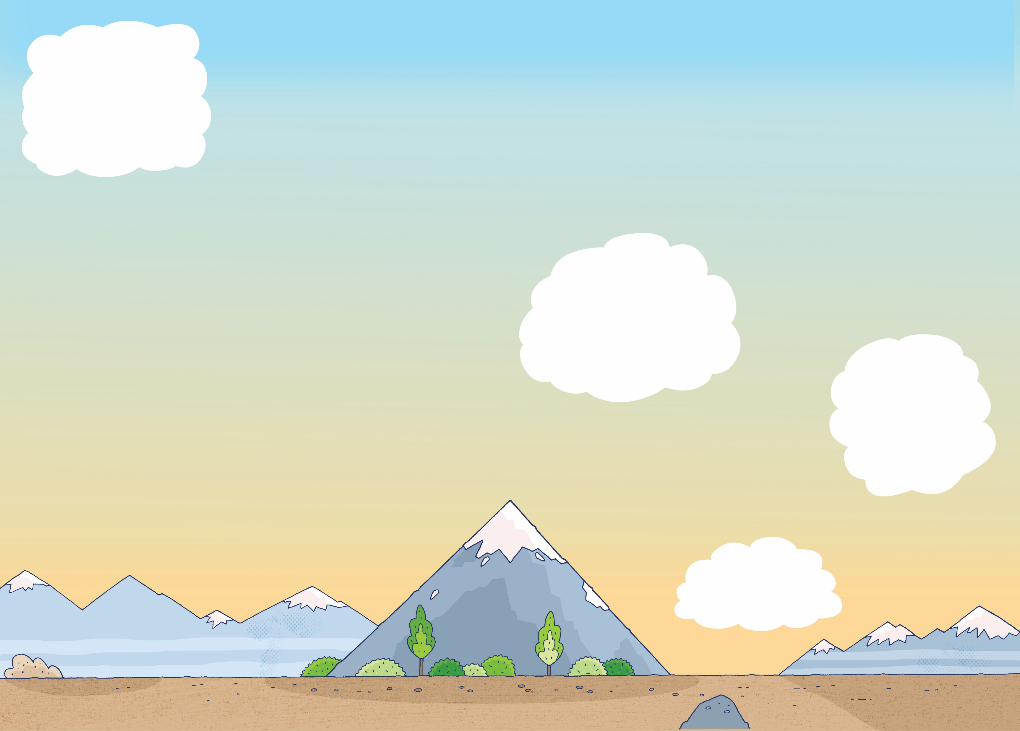
FLYING LESSON 4:
How to fly without wings
Helicopters don’t have wings. Their rotors are combined propellers and wings.
Spinning rotors
Rotors allow a helicopter to take off vertically and fly in all directions.
Spinning rotors
Airships and balloons don’t have wings either…
Lighter-than-air helium gas in here.
Hot air inside the balloon weighs less than the same volume of cooler air outside.
Engine and propeller provides thrust.

Slide 7
GLIDING HIGH
Gliders have wings but no engine. They take to the air with the aid of a powered aircraft or high-speed winch and they use pockets of air to get more lift. If the ground is hot, warm air will rise. Air also rises if wind hits a mountain. If there is no rising air, the glider loses height smoothly and gradually.
Rising hot air is called a thermal. Hawks and other gliding birds also make use of these thermals.

Slide 8
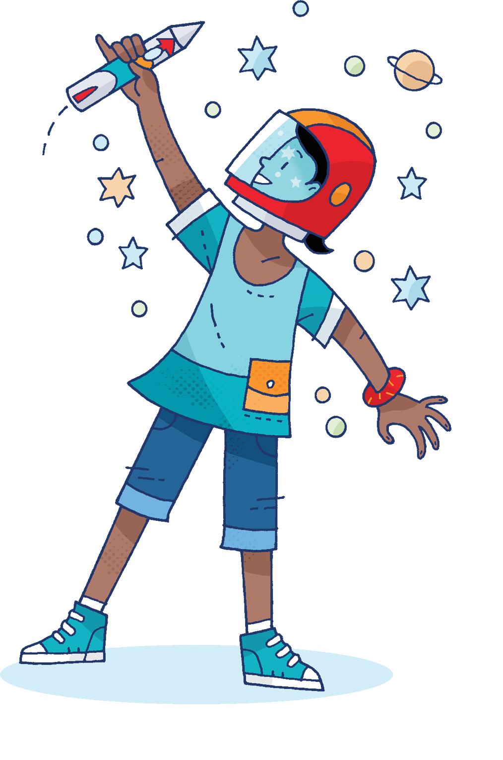
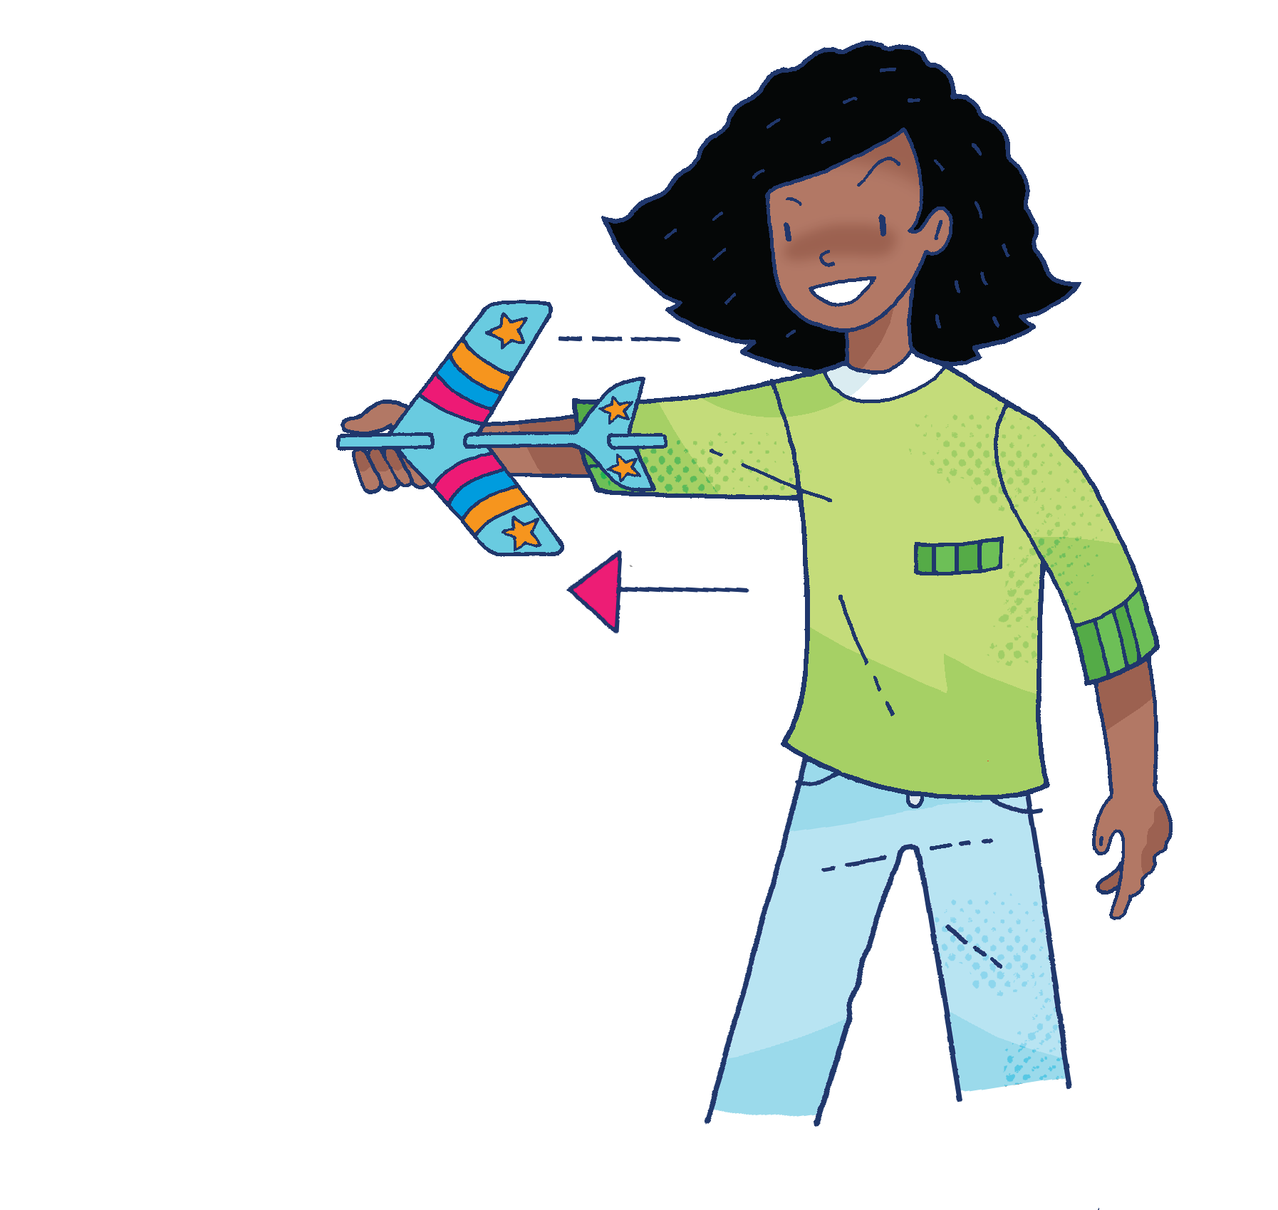
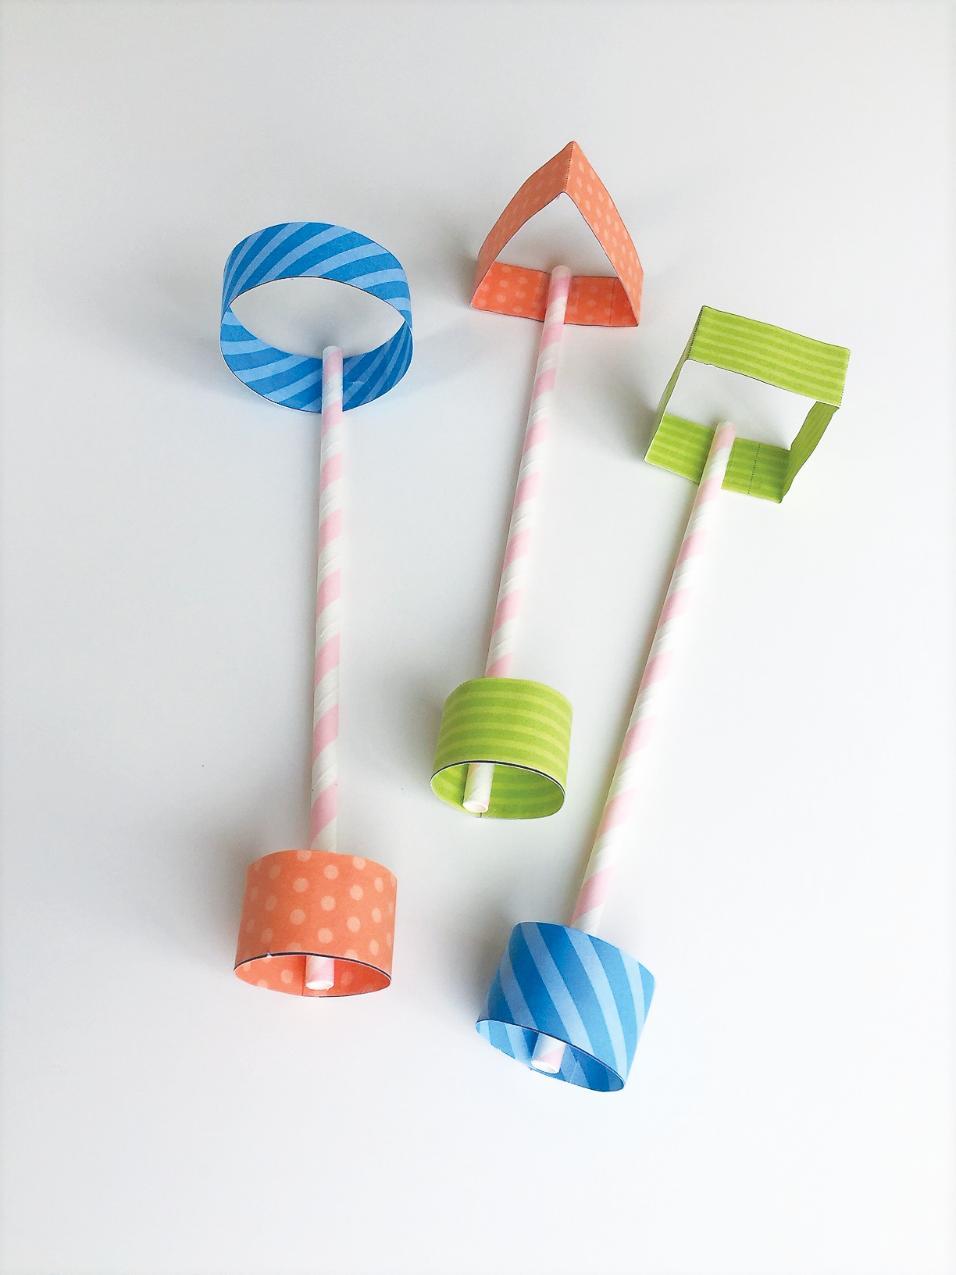
There are lots of different ways to make paper fly. Try these out…
Evaluate
Which one flies the farthest? Can you alter it to make it fly even farther?
Straw planes
Air-powered rocket
Stunt plane

Slide 9
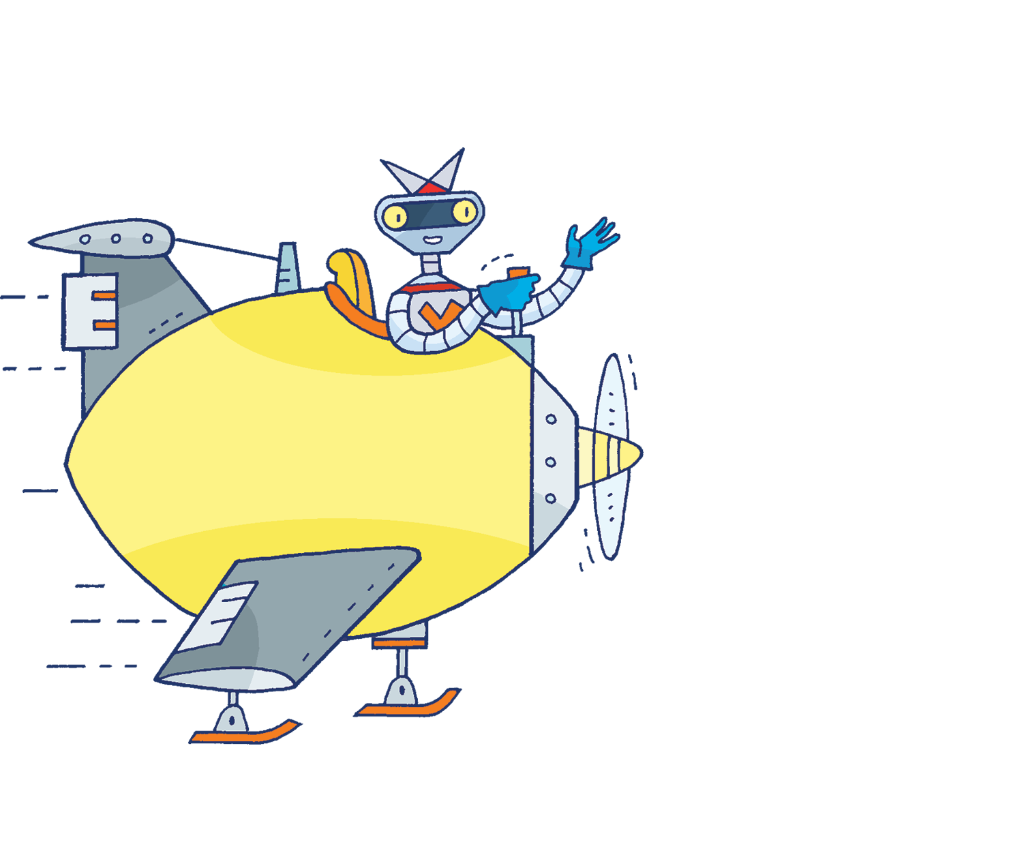
Don’t forget to share your results with the rest of the school. Good luck!

